Slide 1
APPLICATIONS OF STACKS
Parsing
Recursion
Infix to Postfix Expression
Evaluation of Postfix Expression
Infix to Prefix Expression
Tower of Hanoi Problem

Slide 2
A + B - C

Slide 3
A + B × C

Slide 4
(A + B) × C

Slide 5
A + B × (C – D) / E

Slide 6










A + (B × C – (D / E) × G)

Slide 7
7 – (2 × 3 + 5) × (8 – 4/2)

Slide 8
INFIXTOPOSTFIX ( A, STACK, TOP, B )
Step 1. Push “(” onto STACK, and add “)“ to end of the A
Step 2. Scan A from right to left and repeat step 3 to 5 for each element of A until the STACK is empty
Step 3. If an operand is encountered add it to B (postfix exp)
Step 4. If an operator is encountered then:
a. Repeatedly pop from STACK and add to B each operator (on the top of STACK) which has same or higher precedence than the operator.
b. Add operator to STACK, if Step 4.a is not applicable.
EndIf

Slide 9
Step 5. If right parenthesis is encountered then
a. Repeatedly pop from the STACK and add to B (each operator on top of stack until a left parenthesis is encountered)
b. Remove the left parenthesis
EndIf
Step 6. End

Slide 10
Evaluation of postfix expression
Step 1. Create a new stack, STACK.
Step 2. Repeat For every SYMBOL in EXP do
If( SYMBOL = = operand) then
Push(SYMBOL);
Else If (SYMBOL = = operator) then
Set A = pop();
Set B = pop();
Set Result = B operator A;
Push(result);
End If
Done
Step 3. If TOP = = 0 then
PRINT (STACK[TOP])
Else
PRINT “Invalid postfix exp”
End If
Step 4. End

Slide 11






Slide 12
Tower of Hanoi Problem
A
B
C
A
B
C
Given: Three stands A, B and C
Stand A initially has n disks, different size, stacked up,
larger disks are below smaller disks
Problem: to move the n disks to Stand C, subject to
Can move only one disk at a time
Smaller disk should be above larger disk
Can use other stand as intermediate

Slide 13
Tower of Hanoi Problem
A
B
C
Disk 1

Slide 14
Tower of Hanoi Problem
A
B
C
Disk 1
Disk 2

Slide 15
Tower of Hanoi Problem
A
B
C
Disk 1
Disk 2
Disk 3

Slide 16
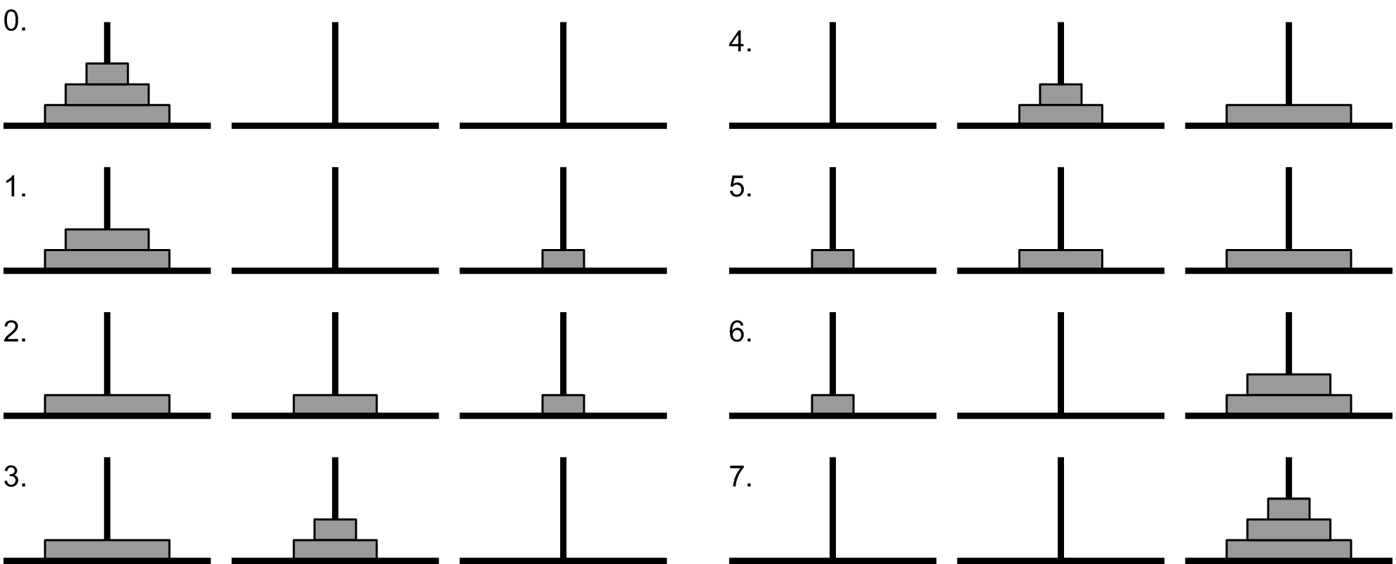
Tower of Hanoi Problem

Slide 17
Tower of Hanoi (Solution!)
For n=3
“Move disk 1 from A to C”
“Move disk 2 from A to B”
“Move disk 1 from C to B”
“Move disk 3 from A to C”
“Move disk 1 from B to A”
“Move disk 2 from B to C”
“Move disk 1 from A to C”

Slide 18
Tower of Hanoi (Solution!)
General Method:
First, move first (n-1) disks from A to B
Now, can move largest disk from A to C
Then, move first (n-1) disks from B to C

Slide 19
Tower of Hanoi Algorithm
TOH (N, SRC, AUX , DES)
Step 1. If N = = 1 then
PRINT("Move Disk N from SRC to DES”)
Else
a. TOH (N-1, SRC, DES, AUX)
b. PRINT ("Move Disk N from SRC to DES”)
c. TOH(N-1, AUX, SRC, DES)
EndIf
Step 2. Exit

Slide 21
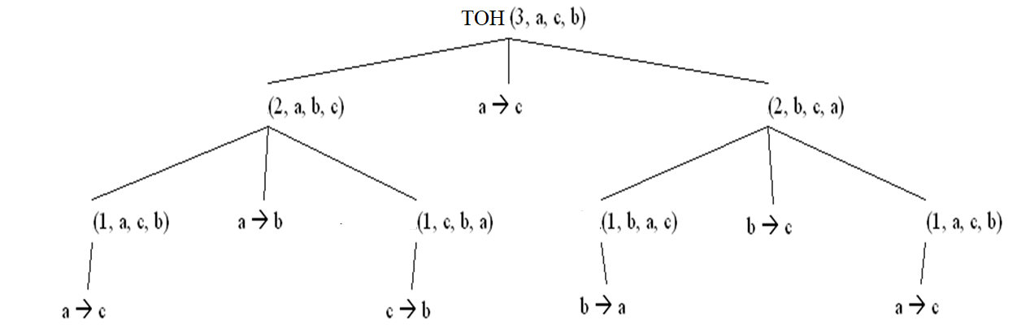
TOH
Disk 3:
TOH
Disk 2:
Disk 2:
TOH
TOH
TOH
TOH
Disk 1:
Disk 1:
Disk 1:
Disk 1:

